Slide 1
Overview of CML & Recent Advances

Slide 2
Introduction
CML is a clonal myeloproliferative neoplasm
Dysregulated production and uncontrolled proliferation of mature and maturing granulocyte with fairly normal differentiation
Fusion of 2 genes: BCR (or chromosome 22) and ABL1 (on chromosome 9), resulting in BCR-ABL1 fusion gene
Final result: Abnormal chromosome 22 called Philadelphia (Ph) chromosome
Final product: BCR-ABL1 fusion protein, a dysregulated tyrosine kinase

Slide 3
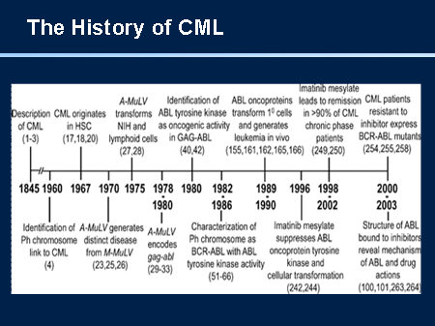

Slide 4
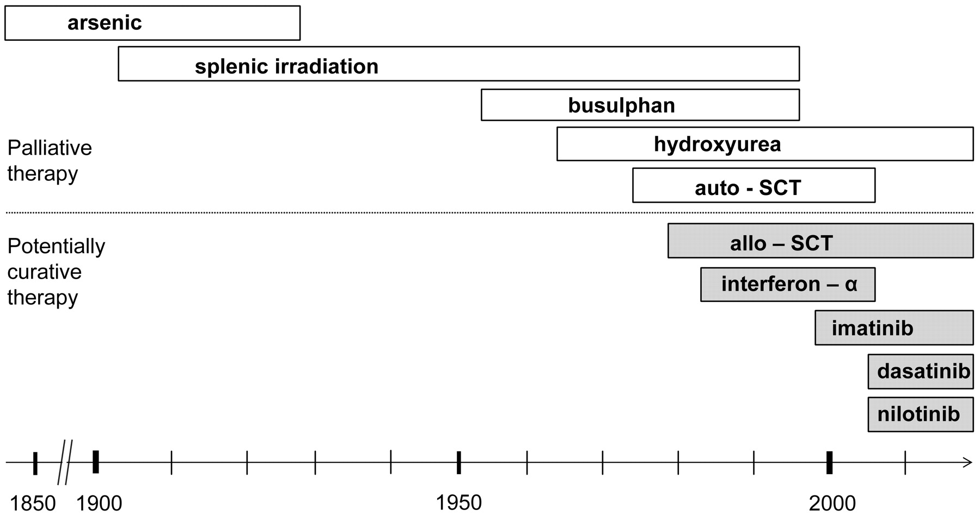
Historical landmarks of CML

Slide 5
Phases of CML (duration without TKI rx)
Advanced phases
Chronic phase
Median duration
5–6 years
Accelerated phase
Median duration
6–9 months
Blast crisis
Median survival
3–6 months

Slide 6
Phases of CML (WHO definition)
CML phase | WHO definition
Chronic stable phase | Peripheral blood blasts fewer than 10% in the blood and bone marrow
Accelerated phase | Blasts 10-19% of white blood cells in peripheral and/or nucleated bone marrow cells ; persistent thrombocytopenia (< 100 × 10⁹/L) unrelated to therapy or persistent thrombocytosis (> 1000 × 10⁹/L) unresponsive to therapy; increasing white blood cells and spleen size unresponsive to therapy; cytogenetic evidence of clonal evolution
Blast crisis | Peripheral blood blasts ≥ 20% of peripheral blood white blood cells or nucleated bone marrow cells; extramedullary blast proliferation; and large foci or clusters of blasts on bone marrow biopsy

Slide 7
Clinical Findings
CML is a disorder of middle age (median age at presentation is 55 years).
Patients usually present with
  Fatigue
  Night sweats &
  Low-grade fever
Often also
  Abdominal fullness related to splenomegaly
Incident finding: elevated white blood count is discovered incidentally

Slide 8
Clinical Findings
Rarely, symptoms of leukostasis
  Blurred vision
  Respiratory distress
  Priapism.
  White blood count >500,000/mcL.
On examination
  Enlarged spleen
  Sternal tenderness
Acceleration of the disease is often associated with fever in the absence of infection, bone pain, and splenomegaly

Slide 9
Laboratory Findings
The hallmark of CML is an elevated white blood count
Median white blood count at diagnosis is 150,000/mcL,
The myeloid series is left-shifted, with mature forms dominating and with cells usually present in proportion to their degree of maturation
Blasts are usually less than 5%. Basophilia and eosinophilia of granulocytes may be present

Slide 10
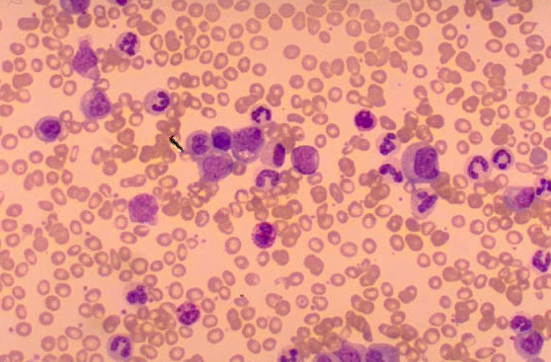
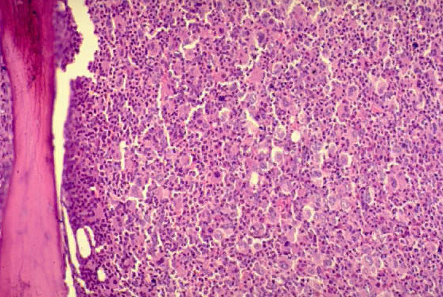
Peripheral Blood Smear

Slide 11
Laboratory Findings
The bone marrow is hypercellular, with left-shifted myelopoiesis Myeloblasts comprise less than 5% of marrow cells.
Polymerase chain reaction (PCR) test
  bcr/abl gene in the peripheral blood test
  the hallmark of the disease
With progression to the accelerated and blast phases
  progressive anemia &
  thrombocytopenia occur
  the percentage of blasts in the blood and bone marrow increases (see micrograph). Blast phase CML is diagnosed when blasts comprise more than 30% of bone marrow cells.

Slide 12
Molecular Genetics of CML
The first genetic abnormality to be associated with a human cancer.
The result of a balanced translocation between chromosomes 9 and 22.
Ph chromosome is acquired and NOT inherited through the germline.

Slide 13
Molecular Genetics of CML
Direct result of the BCR-ABL1 activity, which promotes its development by allowing:
  Uncontrolled proliferation of transformed cells
  Discordant maturation
  Escape from apoptosis
  Altered interaction with the cellular Matrix

Slide 14
Molecular Genetics of CML
{
BCR
q11
BCR
ABL
Ph
22
{
ABL
q34
ABL
BCR
9
9q+

Slide 15
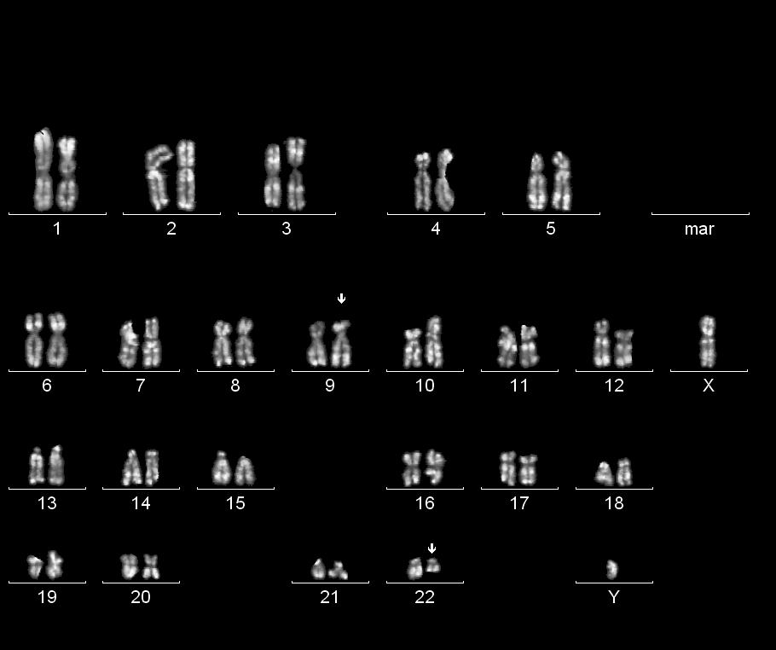
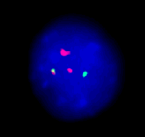
Philadelphia chromosome t(9;22)(q34;q11)
22q- = Philadelphia chromosome

Slide 16
Diagnosis of CML
Typical findings in the blood and bone marrow
Requires the detection of the Ph chromosomal or its product, the BCR-ABL1 fusion mRNA and the BCR-ABL1 protein.
  Conventional cytogenetic analysis (karyotyping) – The first method
  Florence and in situ hybridization (FISH) analysis
  RT-PCR (The BEST)
  Southern blot techniques – rarely used
  Western Blotting – low sensitivity and labor intensive

Slide 17
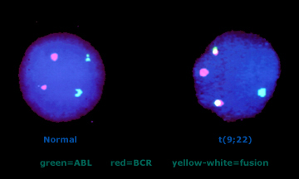
BCR-ABL (FISH)

Slide 18
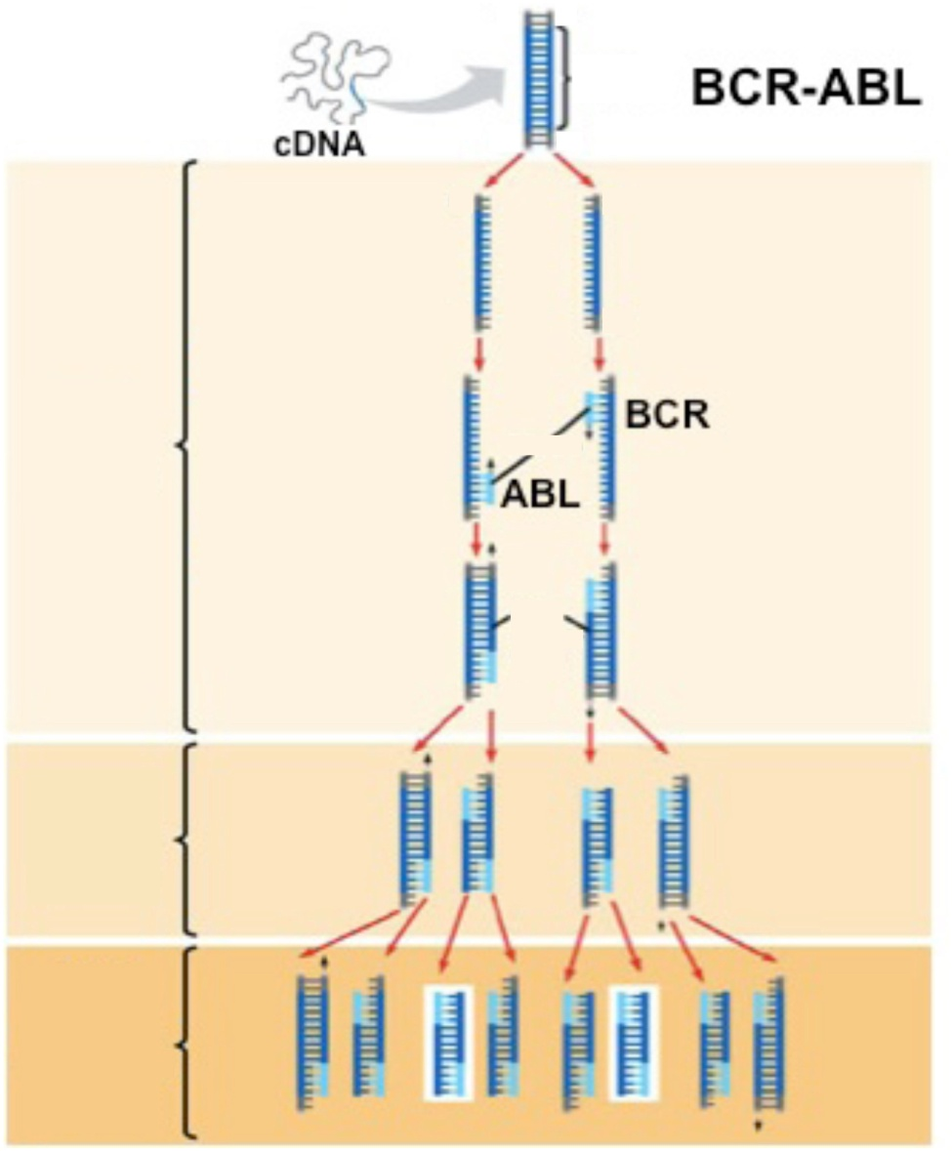
RT-PCR for BCR-ABL
Qualitative RT-PCR allow for the diagnosis of CML
Quantitative RT-PCR is used to quantify the amount of disease
Allows for the identification of cryptic BCR-ABL translocations
Does not require a bone marrow aspirate for optimal results
Target sequence
1
Denaturation: Heat briefly to separate DNA strands
2
Annealing: Cool
to allow primers
to form hydrogen bond with ends
of target sequence
Cycle 1 yields 2 molecules
Primers
3
Extension: DNA polymerase adds nucleotides to the 3” end of each primer
New nucleo-tides
Cycle 2 yields 4 molecules
Cycle 3 yields
8 molecules;
2 molecules
(in white
boxes)
match target sequence

Slide 19
Most CML patients are diagnosed in the chronic phase
Chronic phase
Blastic phase

Slide 20
Differential Diagnosis
Leukemoid reaction
Juvenile myelomonocytic leukemia (JMML)
Chronic myelomonocytic leukemia (CMML)
Atypical CML
Chronic eosinophilic leukemia
Chronic neutrophilic leukemia
Other myeloproliferative neoplasms
Other Ph chromosome positive malignancies

Slide 21
Differential Diagnosis
Reactive leukocytosis associated with infection.
  white blood count is usually less than 50,000/mcL, splenomegaly is absent
  bcr/abl gene is not present
Myeloproliferative disease
  Hematocrit should not be elevated, the red blood cell morphology is normal, and nucleated red blood cells are rare or absent.

Slide 22
Clinical Debate
What is the optimal frontline
therapy for CML?

Slide 23
Principles of CML treatment
Relieve symptoms of hyperleukocytosis, splenomegaly and thrombocytosis.
  Hydration
  Chemotherapy (Busulfan, hydroxyurea)
Control and prolonging the chronic phase (non-curative)
  Tyrosine kinase inhibitors
  Alpha-interferon + chemotherapy
  Chemotherapy (hydroxyurea)

Slide 24
Treatment Options
Treatment decisions for patients with CML are complex, due to the variety of available options, many of which are conflicting.
Potential cure with allogeneic hematopoietic stem cell transplantation
Disease control without cure using tyrosine kinase inhibitors (TKIs)
Palliative therapy with cytotoxic agents

Slide 25
Factors influencing choice of therapy
Phase of CML
Availability of a donor for allogeneic stem cell transplant
Patient age
Presence of medical co-morbidities
Response to treatment with TKIs

Slide 26
Initial Treatment
Tyrosine kinase inhibitors are for first-line therapy in chronic phase CML
Imatinib
Dasatinib
Nilotinib
All 3 agents are considered to be (category 1) based on the NCCN guidelines and recommendations.
Second-generation TKIs (dasatinib or nilotinib) produce faster and deeper response than imatinib

Slide 27
Treatment of CML after failure of initial therapy
A trial of another TKI.
Dasatinib preferred in patients with pancreatitis, elevated bilirubin or hyperglycemia
Dasatinib crosses the blood brain barrier and would therefore be preferred in patients with CNS involvement
Nilotinib might be chosen for patients with a history of pleural or pericardial effusion or disease
Dasatinib and Nilotinib can result in QT prolongation

Slide 28
Other Options
Bosutinib – toxicity is a limiting factor
Ponatinib – toxicity is a limiting factor
Increase the dose of Imatinib
Omacetaxine mepesuccinate – SQ Injection
  Approved by the FDA for patients resistant or intolerant to 2 or more TKIs
Hematopoietic cell transplant – the only cure
Clinical trials

Slide 29
Other Options
Patients who are ineligible for HCT but have either a contraindication to a second-generation TKI or have failed to respond to treatment with available TKI
Interferon alfa plus cytarabine
Hydroxyurea
Busulfan

Slide 30
Mechanisms of action TKIs
They block the initiation of bcr-abl pathway
Many TKIs also affect other signaling pathways
Dasatinib and Bosutinib inhibit both Bcr-Abl and Src kinases.
Nilotinib inhibits Bcr-Abl, c-kit and platelet derived growth factor receptor (PDGFR)
These differences in targeted pathways may be responsible for their varied clinical effects in tumors

Slide 31
TKIs in CML, the gold rush
 | Date of FDA approval |  | First Line | Second Line
 | 1st | 2nd
Imatinib | 2002 | 2001 | Gold standard | No published experience
Dasatinib | 2010 | 2006 | Early data suggest a small advantage over Imatinib | 40-50% CCyR
Nilotinib | 2010 | 2007 | Early data suggest a small advantage over Imatinib | 40-50% CCyR
Bosutinib |  | 2012 | Not yet clear, maybe slightly better than imatinib | 40-50% CCyR
Ponatinib |  | 2013? | EPIC | 10-30% of responses in 3rd line (T315I active)
Thanks to David Marin

Slide 32
Resistance to Imatinib occurs predominantly during advanced phase CML
Advanced stage cancers are characterized by multiple genetic changes
Patients in advanced phase often relapse with the development of chemotherapy resistance
Some patients in blast crisis CML respond to Imatinib but then tends to relapse
Chronic Phase
Blast Crisis
Relapse
Hematopoietic
differentiation
Bone marrow to
peripheral blood
Ph-negative
Ph+ blasts
Ph+
Ph+ Imatinib mesylate-
resistant blasts

Slide 33
Resistance to treatment
Primary resistance – patient fails to achieve a desired response to initial treatment
Secondary resistance – patient with an initial response to a TKI ultimately relapses

Slide 34
Loss of Response
Patients should be re-evaluated with a bone marrow biopsy with cytogenetics, and BCR-ABL kinase mutation analysis
T315I mutation
  Resistant to all TKIs, except Ponatinib
  Patient should be evaluated for SCT
Y253H, E255k/V and F359V/C/I mutations
  Resistant to Imatinib and Nilotinib but sensitive to Dasatinib
F317L/V/I/C, V299L and T315A mutations
  Sensitive to Nilotinib but with intermediate sensitivity to Imatinib and Dasatinib

Slide 35
Clinical Evidence of Imatinib

Slide 36
IRIS Study Design: Imatinib Mesylate
Versus IFN-α + ara-C
1106 patients enrolled from June 2000 to January 2001
Imatinib Mesylate
IF:
·
Loss of MCR or CHR
·
Increasing WBC count
S
R
·
Intolerance of treatment
Crossover
·
Failure to achieve MCR
at 12 months*
·
Failure to achieve CHR at 12 months*
·
Request to discontinue IFN-α*
IFN-
a
+ ara-C
Progression
·
Increasing WBC count
S = screening.
R = randomization.
·
Loss of MCR or CHR
·
Accelerated phase or blast crisis
·
Death

Slide 37
Hematologic Responses
100
96%
90
Imatinib mesylate
80
70
60
67%
% Responding
50
IFN-α + ara-C
40
30
20
10
0
0
3
6
9
12
15
18
21
Months Since Randomization

Slide 38
Cytogenic Responses
100
90
80
83%
Imatinib mesylate
70
60
% Responding
50
40
30
20
20%
10
IFN-α + ara-C
0
0
3
6
9
12
15
18
21
Months Since Randomization

Slide 39
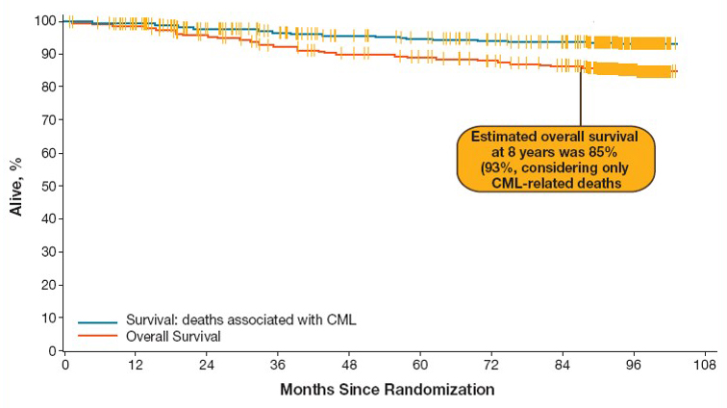
Overall Survival on First-Line Imatinib (IRIS Study)

Slide 40
IRIS 8-Year Update: Outcome After Imatinib
37%
Deininger M et al; Blood 2009;114(22):462.

Slide 41
ENESTnd 24-Month Update: Continued Superiority of Nilotinib Versus Imatinib In Patients with Newly Diagnosed CML-CP
Hughes TP, et al. Blood. 2010;116(21):94-95 [abstract 207]
ENESTnd: Evaluating Nilotinib Efficacy and Safety in
Clinical Trials–Newly Diagnosed Patients
Notes:
41

Slide 42
Study Design and Endpoints
R
A
N
D
O
M
I
Z
ED
*
Nilotinib 300 mg BID (n = 282)
N = 846
217 centers
35 countries
Nilotinib 400 mg BID (n = 281)
Imatinib 400 mg QD (n = 283)
Follow-up
5 years
Primary endpoint: MMR at 12 months
Key secondary endpoint: Durable MMR at 24 months
Other endpoints: CCyR, time to MMR and CCyR, EFS, PFS, time to AP/BC, OS
Hughes TP, et al. Blood. 2010;116(21):94-95 [abstract 207]
Notes:
42

Slide 43
MMR AT 12 and 24 Months*
P < . 0001
P < .0001
P < . 0001
P < .0001
% With MMR
n = 282
n = 281
n = 283
n = 282
n = 281
n = 283
MMR at 12 months¹
MMR at 24 months
Nilotinib 300 mg BID
Nilotinib 400 mg BID
Imatinib 400 mg QD
Durable MMR at 24 months: Less than 2% of patients in each treatment arm lost
MMR between 12 and 24 months
*ITT population
1. Saglio G, et al. NEJM. 2010;362:2251-2259.
Data cut-off: 20Aug2010
Notes:
43

Slide 44
Cumulative Incidence of MMR*
100
n
Nilotinib 300 mg bid
282
90
Nilotinib 400 mg bid
281
By 24 months
80
Imatinib 400 mg qd
283
71%, P < .0001
By 12 months
70
55%, P < .0001
60
67%, P < .0001
% with MMR
Δ 23%-27%
50
51%, P < .0001
40
Δ 24%-28%
44%
30
20
27%
10
0
0
3
6
9
12
15
18
21
24
27
30
33
Time since randomization (Months)
*ITT population
Data cut-off: 20Aug2010
Notes:
44

Slide 45
CCyR Rates by 24 Months*
P = .0018
P = .016
% With CCyR
n = 282
n = 281
n = 283
*ITT population

Slide 46
Suboptimal Response and
Treatment Failure by 18 Months*
% of Patients
n = 282
n = 281
n = 283
n = 282
n = 281
n = 283
*ITT population
Suboptimal response: < PCyR at 6 months; < CCyR at 12 months; < MMR at 18 months
Treatment failure: No CyR at 6 months; < PCyR at 12 months; < CCyR at 18 months; at any time within 18 months loss of CHR, loss of CCyR, progression to AP/BC, or clonal evolution
Patients satisfying criteria for both suboptimal response and treatment failure were counted as treatment failure
Data cut-off: 20Aug2010
Notes:
46
46

Slide 47
Progression to AP/BC on
Core Treatment*†
P = .0059
P = .0003
P = .0196
P = .0089
Number of Patients
0.7%
1.1%
4.2%
0.7%
1.8%
6.0%
Including Clonal Evolution
Nilotinib 300 mg BID
Nilotinib 400 mg BID
Imatinib 400 mg QD
*ITT population
†Progression to AP/BC or death due to CML while on core treatment
Data cut-off: 20Aug2010
Notes:
47

Slide 48
PFS on Core Treatment*†
 | Nilotinib 300 mg BID n = 282 | Nilotinib 400 mg BID n = 281 | Imatinib 400 mg QD n = 283
Number of events | 5 | 4 | 12
Estimated 24-month rate of PFS | 98.0% | 97.7% | 95.2%
P value | 0.0736 | 0.0437 | –
*ITT population
†Progression to AP/BC or death due to any cause while on core treatment
Data cut-off: 20Aug2010
Notes:
48
48

Slide 49
Overall Survival*†
 | Nilotinib 300 mg BID n = 282 | Nilotinib 400 mg BID n = 281 | Imatinib 400 mg QD n = 283
Total number of deaths | 9 | 6 | 11
Estimated 24-month rate of OS | 97.4% | 97.8% | 96.3%
P-value (OS) | 0.6485 | 0.2125 | –
CML-unrelated | 4 | 3 | 1
CML-related | 5 | 3 | 10
*ITT population
†Including deaths after discontinuation of core treatment
Notes:
49
49

Slide 50
Grade 3/4 Myelosuppression
21
% of Patients
12
11
12
10
9
4
5
4
Anemia
Neutropenia
Thrombocytopenia
Nilotinib 300 mg BID
Nilotinib 400 mg BID
Imatinib 400 mg QD
Data cut-off: 20Aug2010
Notes:
50
50

Slide 51
Selected Grade 3/4 Biochemical Abnormalities
9
8
8
7
6
5
% of Patients
4
4
3
3
< 1
0
Lipase ↑
ALT ↑
Total bilirubin ↑
Glucose ↑
Nilotinib 300 mg BID
Nilotinib 400 mg BID
Imatinib 400 mg QD
Data cut-off: 20Aug2010
Notes:
51
51

Slide 52
ENESTnd 24-Month Update
Nilotinib continues to demonstrate:
  Superior CCyR, MMR, and CMR.
  Significantly fewer progressions to AP/BC.
  Lower rates of suboptimal response and treatment failure.
Nilotinib at both doses was generally well-tolerated, and fewer adverse events lead to discontinuation in the nilotinib 300 mg BID arm.
Longer follow-up supports the superiority of nilotinib for the treatment of patients with newly diagnosed CML-CP.
Notes:
52

Slide 53
Dasatinib versus Imatinib Study in Treatment-Naïve CML: DASISION (CA180-056)
Dasatinib 100 mg QD (n = 259)
N = 519
108 centers
26 countries
Follow-up
5 years
Randomized*
Imatinib 400 mg QD (n = 260)
*Stratified by Hasford risk score
Primary endpoint: Confirmed CCyR by 12 months
Secondary/other endpoints: Rates of CCyR and MMR; times to confirmed CCyR, CCyR and MMR; time in confirmed CCyR and CCyR; PFS; overall survival
Shah et al. ASH 2010; abst #206.

Slide 54
DASISION: First-Line Dasatinib vs Imatinib in CML-CP
CCyR Rate by 12 Months (ITT)
P = 0.0011
P = 0.0067
CCyR
(%)
CCyR
by 12 months
Confirmed CCyR
by 12 months
Kantarjian. N Engl J Med 362: 2260, 2010.

Slide 55
DASISION: Progression to AP-BP (ITT)
100
n/N 6/259 9/260
No patient who achieved MMR progressed to AP/BP CML
5 patients who achieved a CCyR progressed to AP/BP CML
(2 dasatinib, 3 imatinib)
Rates of progression-free survival at 18 mos: 94.9% for dasatinib and 93.7% for imatinib
Shah N et al. Blood 2010;116: Abstract 206.

Slide 56
DASISION: Confirmed CCyR (ITT)
P = 0.0086
P = 0.0366
Shah N et al. Blood 2010;116: Abstract 206.

Slide 57
DASISION: Grade 3/4 Cytopenia
100
Grade 3/4 bleeding occurred in 2 patients on dasatinib and
3 patients on imatinib
6 patients on dasatinib and 3 patients on imatinib D/C Rx due
to cytopenia
Shah N et al. Blood 2010;116: Abstract 206.

Slide 58
Early efficacy of nilotinib and dasatinib
in comparison to imatinib
 | ENESTnd |  |  | DASISION
 | imatinib | nilotinib | difference | imatinib | dasatinib | difference
CCyR at 12 month | 65% | 80% | 15 | 73% | 85% | 12
CCyR at 24 month | 77% | 87% | 10 | 82% | 85% | 3
PFS at 24 month | 95.2% | 98.0% | 3 | 92.1% | 93.7% | 2
OS at 24 month | 96.3 | 97.4% | 1 | 95.2% | 95.3% | 0
Blue indicates a statistically significant difference
Red indicates a non significant difference
Saglio et al, NEJM 2010
Kantarjian et al, NEJM 2010
Kantarjian et al, Lancet Onc 2011
Kantarjian et al, Blood 2012

Slide 59
Bosutinib versus Imatinib in Newly Diagnosed Chronic Phase Chronic Myeloid Leukemia — BELA Trial: 24-Month Follow-Up
Cortes JE et al.
Proc ASH 2011;Abstract 455.

Slide 60
Study Design
Bosutinib (n = 250)
PO 500 mg/d
Eligibility (n = 207)
Patients with newly diagnosed CP-CML
R
Imatinib (n = 252)
PO 400 mg/d
Randomization was stratified by Sokal
risk score and geographic location
Primary endpoint
Complete cytogenic response (CCyR) at 12 months in the intent-to-treat population
Secondary endpoints
Major molecular response (MMR) at 12 months; time to CCyR and MMR; duration of CCyR and MMR; time to and incidence of transformation to accelerated/blast phase (AP/BP) CML; event-free survival (EFS) and overall survival (OS)
Cortes JE et al. Proc ASH 2011;Abstract 455.

Slide 61
Cytogenic Response Rates
CCyR | Bosutinib (n = 248) | Imatinib (n = 250)
At 3 months | 50% | 25%
At 6 months | 59% | 49%
At 9 months | 63% | 55%
At 12 months | 70% | 68%
At 18 months | 62% | 67%
Cumulative rate by 18 months | 79% | 79%
Median time to CCyR was 12.7 weeks (bosutinib) and 24.6 weeks (imatinib).
Median treatment duration was 19.3 months (bosutinib) and 19.5 months (imatinib).
Cortes JE et al. Proc ASH 2011;Abstract 455.

Slide 62
Molecular Response Rates
MMR | Bosutinib (n = 248) | Imatinib (n = 250)
At 3 months | 7% | 3%
At 6 months | 28% | 11%
At 9 months | 35% | 19%
At 12 months | 41% | 27%
At 18 months | 46% | 38%
Cumulative rate by 18 months | 55% | 45%
Median time to MMR was 36.9 weeks (bosutinib) and 72.3 weeks (imatinib).
Cortes JE et al. Proc ASH 2011;Abstract 455.

Slide 63
Other Trial Outcomes
Endpoint | Bosutinib (n = 248) | Imatinib (n = 250)
Transformation to AP/BP CML on treatment | 2% | 5%
EFS rate (18 months) | 95% | 91%
OS rate (18 months) | 99% | 95%
On-study deaths Due to CML progression | 2% 2% | 5% 4%
Median on-treatment EFS and OS were not reached for either of the treatment arms.
Patients still receiving treatment: bosutinib (67%) and imatinib (74%)
Cortes JE et al. Proc ASH 2011;Abstract 455.

Slide 64
Adverse Events (AEs)
Event | Bosutinib (n = 248) | Imatinib (n = 250)
Diarrhea | 69% | 22%
Vomiting | 32% | 14%
Pyrexia | 18% | 10%
Abdominal pain | 13% | 7%
Peripheral edema | 4% | 11%
Periorbital edema | 1% | 14%
Muscle cramps | 4% | 22%
Increased ALT (Grade 3/4) | 23% | 4%
The primary reason for bosutinib discontinuation was toxicity (23%).
The primary reason for imatinib discontinuation was disease progression (13%).
Cortes JE et al. Proc ASH 2011;Abstract 455.

Slide 65
Conclusions
Bosutinib therapy resulted in a higher MMR rate at 12 months, faster times to MMR and CCyR, fewer events of transformation to AP/BP CML and fewer overall and CML-related deaths compared to imatinib.
In addition, 18-month estimates of EFS and OS favor bosutinib over imatinib therapy.
Both bosutinib and imatinib were associated with acceptable but distinct toxicity profiles.
These data suggest that bosutinib is superior to imatinib and may offer a new therapeutic option in patients with newly diagnosed CP-CML.
Cortes JE et al. Proc ASH 2011;Abstract 455.

Slide 66
Comparison of TKIs

Slide 67
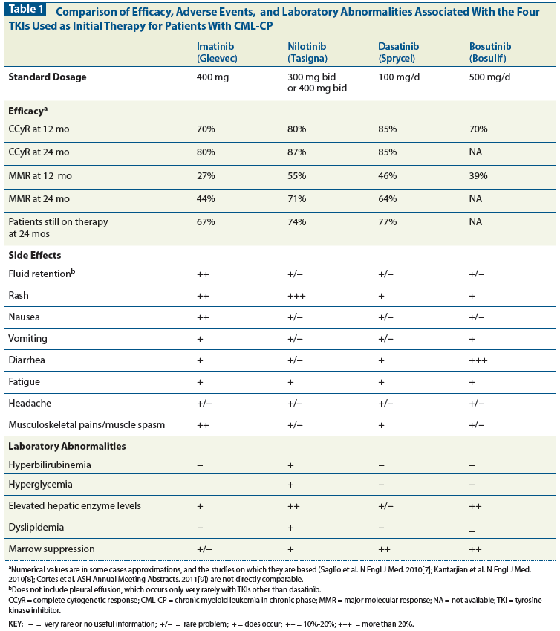
TKIs: Efficacy

Slide 68
TKIs: Side effects

Slide 69
TKIs: Lab Investigations

Slide 70
Response evaluation
Hematologic complete remission, with normalization of blood counts and splenomegaly
  Should be achieved in 3 months, , ideally within 6 months but certainly within 12 months
“Major cytogenetic response" : < 35% of metaphases contain the Philadelphia chromosome
“Complete cytogenetic response“: absence of the abnormal chromosome by standard cytogenetic testing.
Quantitative assessment of the bcr/abl gene using PCR assays is the standard method of assessment.

Slide 71
The current goal of therapy is to achieve a good molecular response, with at least a 3-log reduction in bcr/abl level. This roughly corresponds to a bcr/abl ratio (compared to abl) of less than 0.03.
Patients who achieve this level of molecular response have an excellent prognosis, with 100% of such patients remaining free of progression at 6 years

Slide 72
Patients with suboptimal molecular responses are best treated by switching from imatinib to an alternative tyrosine kinase inhibitor such as dasatinib (or nilotinib)
Dasatinib appears to be a more potent agent and can overcome approximately 90% of the mutations that can form in bcr/abl and limit the effectiveness of imatinib.
  Dose: 100 mg/d
  Dependent on an acid environment for absorption

Slide 73
Response by type | Definitions
Hematologic
Complete | WBC <10 x 10⁹/L
 | Basophils <5 percent
 | No myelocytes, promyelocytes, myeloblasts in the differential
 | Platelet count <450 x 10⁹/L
 | Spleen nonpalpable
Cytogenetic*
Major | Complete: No Ph+ metaphases or <1 percent BCR-ABL1-positive nuclei of at least 200 nuclei on FISH
 | Partial: 1 to 35 percent Ph+ metaphases
Minor | 36 to 65 percent Ph+ metaphases
Minimal | 66 to 95 percent Ph+ metaphases
None | >95 percent Ph+ metaphases

Slide 74
Response by type | Definitions
Molecular
MR^{4.5} | Detectable disease with ratio of BCR-ABL to ABL (or other housekeeping genes) ≤0.0032 percent (≥4.4 log reduction) on the international scale (IS) or Undetectable disease in cDNA with ≥32,000 ABL transcripts
MR⁴ | Detectable disease with ratio of BCR-ABL to ABL ≤0.01 percent (≥4 log reduction) on the IS or Undetectable disease in cDNA with ≥10,000 ABL transcripts
MR³ | Detectable disease with ratio of BCR-ABL to ABL (or other housekeeping genes) ≤0.1 percent (≥3 log reduction) on the IS

Slide 75
Definition of the response to tyrosine kinase inhibitors as first-line treatment of chronic myeloid leukemia
 | Optimal | Warning | Failure
Baseline | NA | High risk or CCA/Ph+, major route | NA
Three months | BCR-ABL1 ≤10 percent and/or Ph+ ≤35 percent | BCR-ABL1 >10 percent and/or Ph+ 36 to 95 percent | Non-CHR and/or Ph+ >95 percent
Six months | BCR-ABL1 <1 percent and/or Ph+ 0 | BCR-ABL1 1 to 10 percent and/or Ph+ 1 to 35 percent | BCR-ABL1 >10 percent and/or Ph+ >35 percent
12 months | BCR-ABL1 ≤0.1 percent | BCR-ABL1 >0.1 to 1 percent | BCR-ABL1 >1 percent and/or Ph+ >0
Then, and at any time | BCR-ABL1 ≤0.1 percent | CCA/Ph– (–7, or 7q–) | Loss of CHR Loss of CCyR Confirmed loss of MMR* Mutations CCA/Ph+

Slide 76
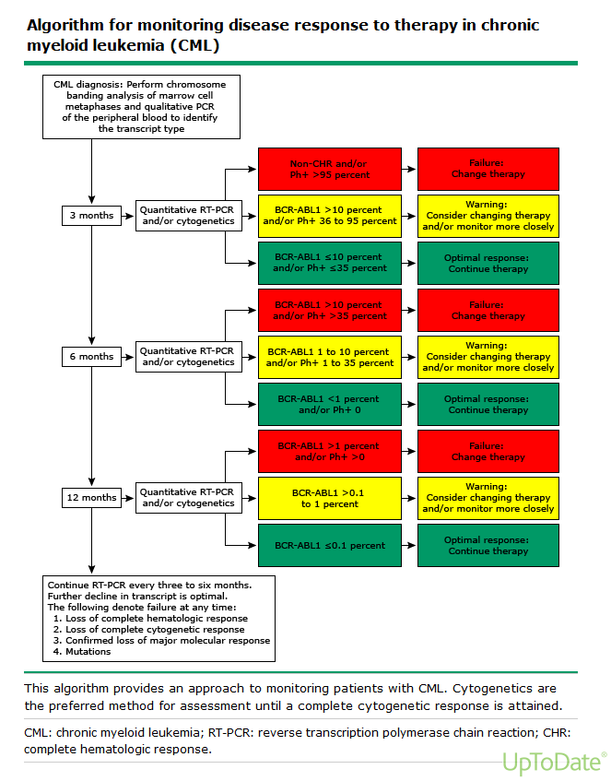

Slide 77
Allogeneic bone marrow transplantation
The only proven curative therapy for CML is allogeneic bone marrow transplantation
Best results (80% cure rate) are obtained in patients who are under 40 years of age and transplanted within 1 year after diagnosis from HLA-matched siblings.
The introduction of imatinib has changed the approach to allogeneic transplant for CML. Allogeneic transplantation is reserved for patients in whom disease is not well controlled, in whom disease progresses after initial control, or for those who have accelerated phase disease.

Slide 78
European LeukemiaNet Recommendations for the Management of CML

Slide 79
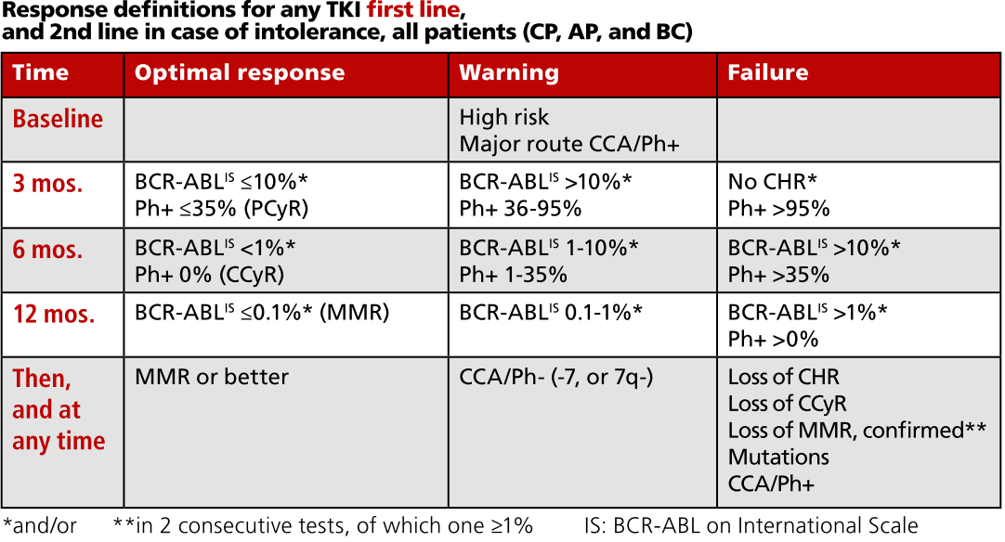
ELN Recommendation

Slide 80
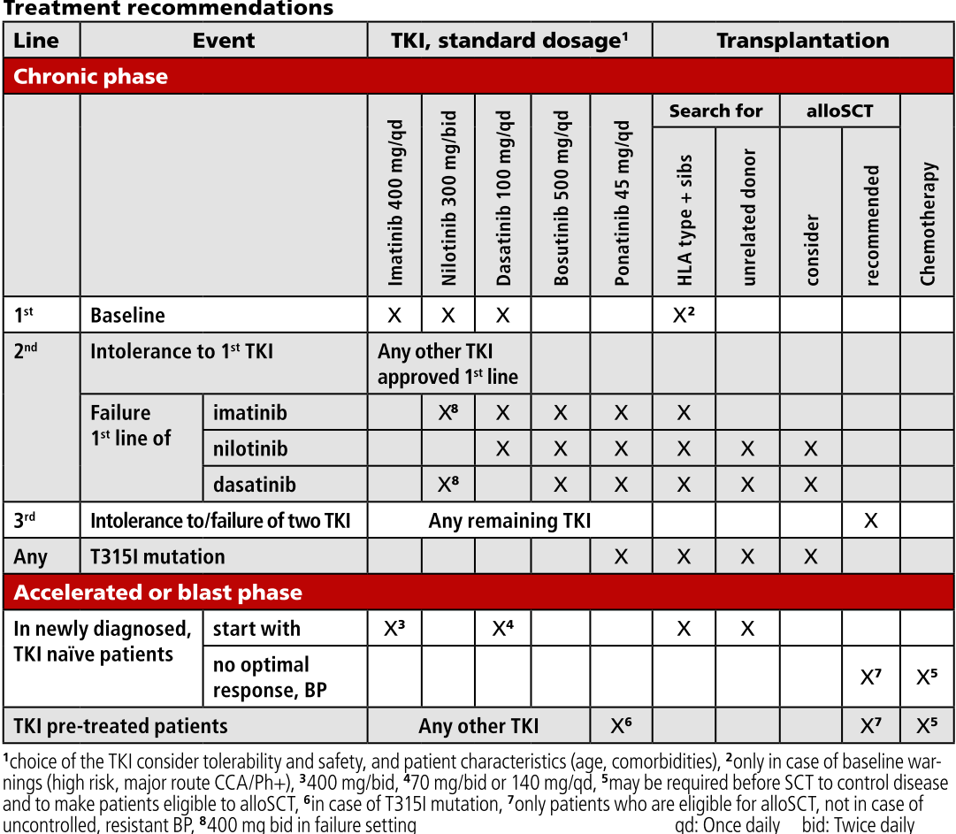

Slide 81
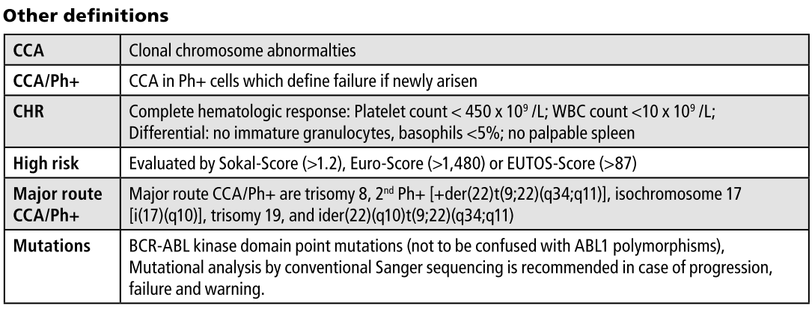
ELN Recommendation

Slide 82
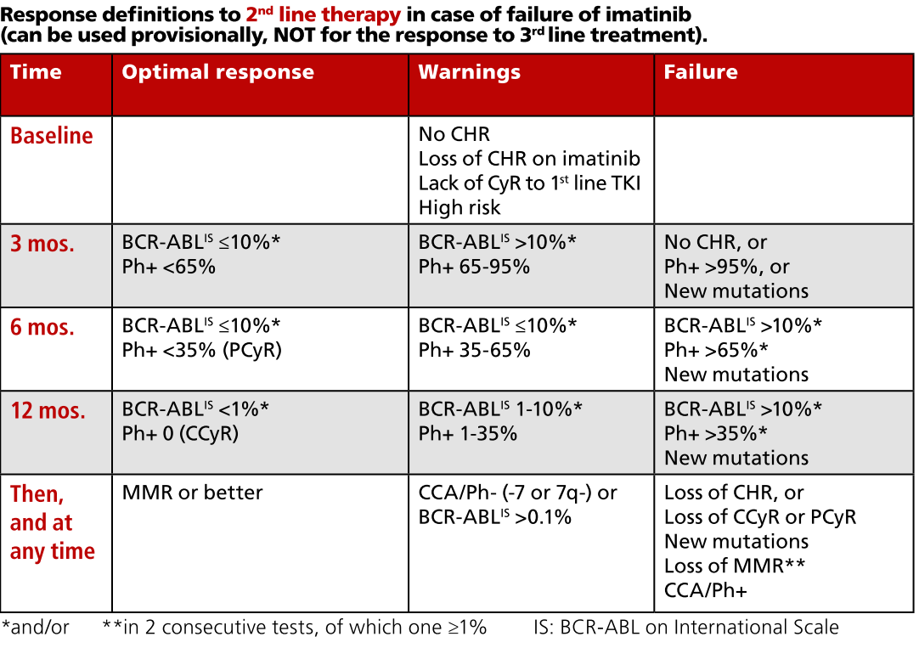

Slide 83
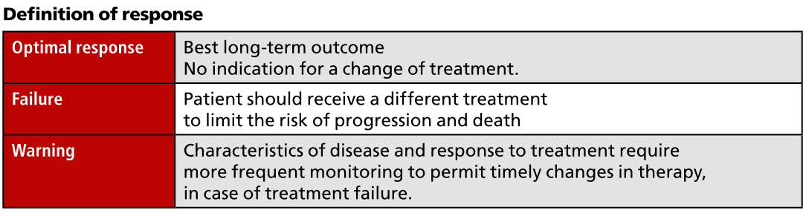
ELN Recommendation

Slide 84
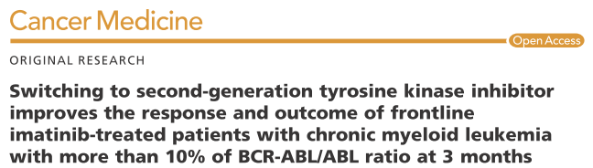
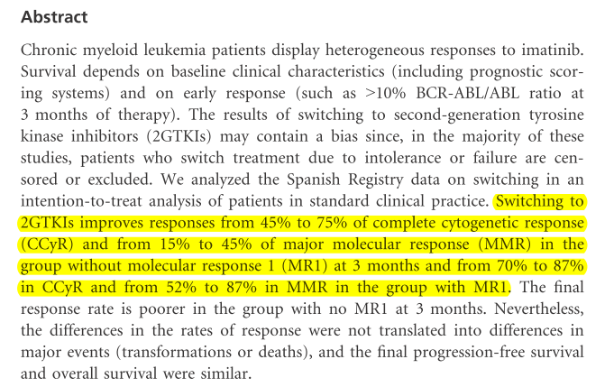

Concept of early switch to 2nd gen TKI

Slide 85
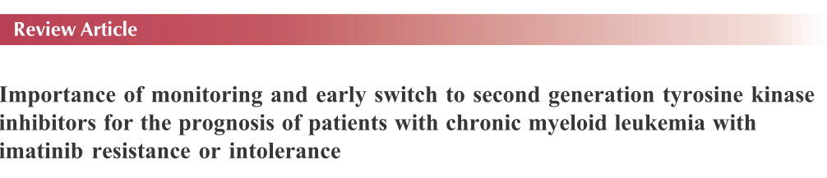
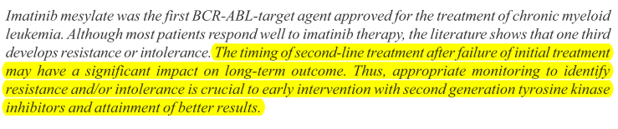

Slide 86
How to childhood CML
Blood
Volume 119(8):1821-1830
February 23, 2012

Slide 87
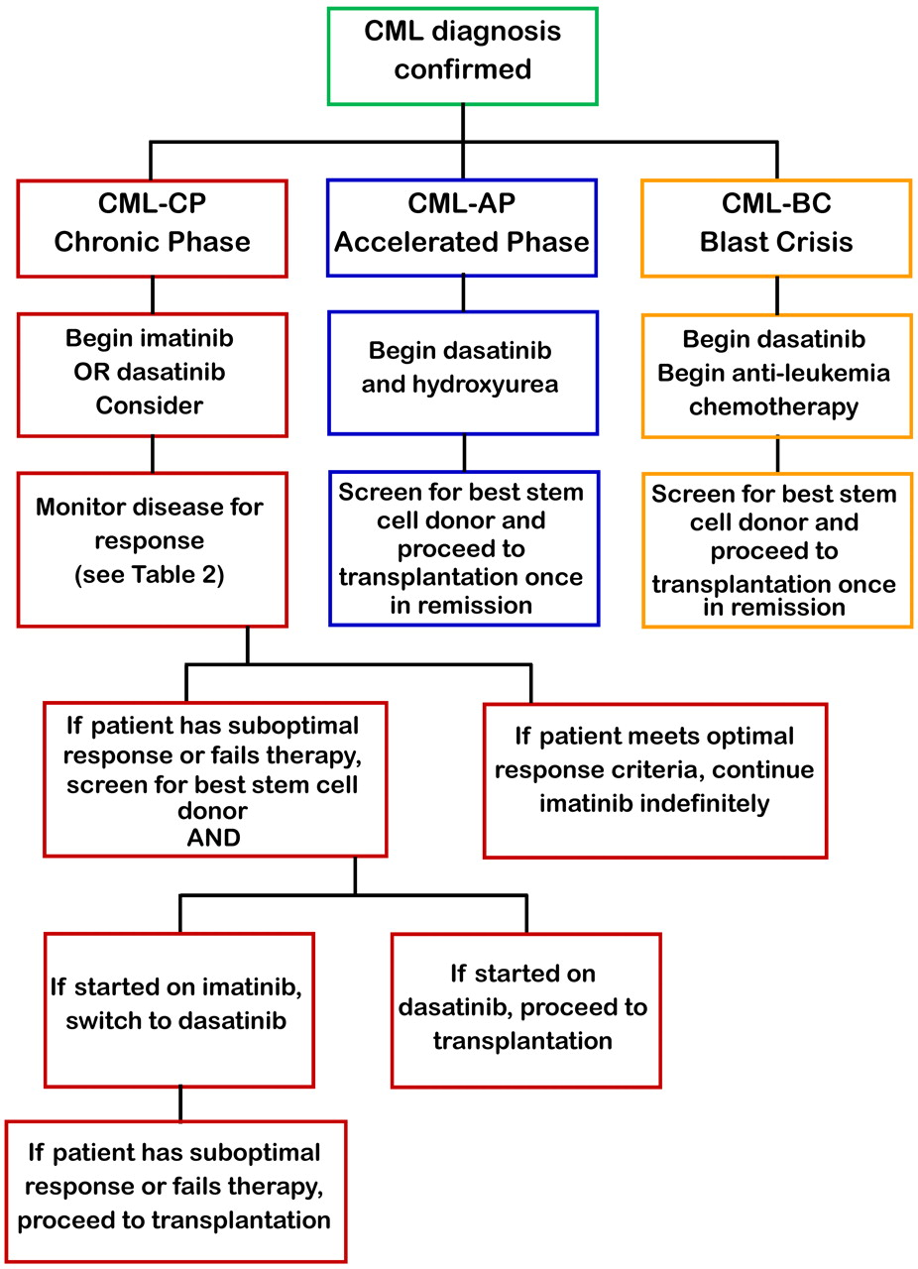
Flowchart for the management of pediatric CML.
Jeffrey R. Andolina et al. Blood 2012;119:1821-1830
Notes:
Flowchart for the management of pediatric CML.

Slide 88
Recent Advances

Slide 89
Recent STOP TKI Studies
EURO-SKI (European LeukemiaNet Stop TKI) study
French STOP-2G-TKI study
ISAV (Imatinib Suspension And Validation) study
KIDS (Korean Imatinib Discontinuation) study

Slide 90
EURO-SKI (European LeukemiaNet Stop TKI) study
Aims of EURO-SKI
  To define prognostic markers to increase the rate of patients in durable deep MR after stopping TKI
  Evaluation of harmonized methods of molecular monitoring
  Assessment of quality of life
  Calculation of saved treatment costs per country
ASH 2014, Abstract # 151

Slide 91
EURO-SKI study: Methods
Patient population:
  Adult CML patients in chronic phase CML on TKI treatment
  In confirmed deep molecular response (MR⁴, BCR-ABL <0.01%) for at least one year (>4 log reduction on TKI therapy for >12 months confirmed by three consecutive PCR tests) &
  Under TKI treatment for at least 3 years
  Patients (pts) after a prior TKI failure were excluded
Primary endpoint was the assessment of the duration of MR (defined by continuous MMR) after stopping TKI
Interim analysis was planned after 200 patients with eligible molecular results at month (mo) 6

Slide 92
EURO-SKI study: Results
From 200 pts Male 58.5%,Female 41.5%
Median age at diagnosis 53.5 yrs
1st line TKI- Imatinib (97%), Dasatinib (1.5%) & Nilotinib (1.5%)
Median duration of TKI treatment- 8 yrs (3-12.6 yrs)
TKI treatment duration:
  <5 yrs-16%
  5-8 yrs-36%
  >8 yrs-48%
Median duration of MR⁴ before TKI cessation- 5.4 yrs (1-11.7yrs)
MR⁴ duration:
  <2 yrs- 8%
  2-5 yrs-37%
  5-8 yrs-39%
  >8 yrs-16%

Slide 93
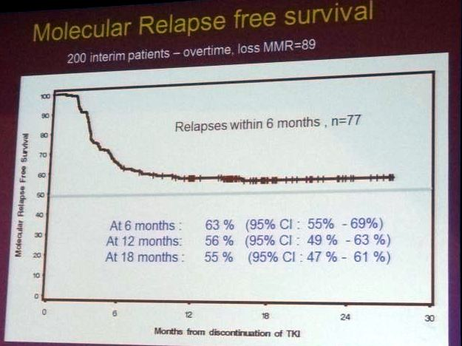
EURO-SKI study: Results
123 of 200 pts (61.5%) patients remained without relapse at 6 months
There have been no progressions to advanced phases

Slide 94
EURO-SKI study: Results
Recurrence of CML, defined as loss of MMR
  43/92 pts (47%) treated <8 years
  23/87 pts (26%) treated for >8 years (p= 0.005)
Patients who lost MMR within 6 mo
  33/71 pts with MR⁴ <5 years (46%) lost MMR within 6 mo
  28/87 pts (32%) with MR⁴duration >5 years (p=0.07).
No significant difference was observed for relapse within 6 mo according to depth of molecular response at discontinuation (MR⁴ vs MR^{4.5} vs MR⁵)

Slide 95
EURO-SKI study: Results
TKI cessation was a safe procedure overall
  Only 31 of the 200 patients experienced stopping-related side effects, mostly pain in muscles, joints or bones, but also sweating, skin problems, depressive episodes, tiredness or weight loss. (TKI withdrawal syndrome)
  None of the side effects were very severe (grade 4)
Estimated total savings for the community within the EURO-SKI trial were estimated at 7 million Euros

Slide 96
EURO-SKI study: Conclusion
Employing a standardized molecular testing can increase the chance to stay in treatment-free remission than previously reported.
The EURO-SKI trial will further elucidate the prognostic factors but the preliminary results confirm the prognostic impact of the duration of TKI therapy before stopping

Slide 97
French STOP-2G-TKI study
Prospective trials such as STIM, TWISTER and EUROSKI suggest that imatinib may be successfully stopped in pts with deep and sustained molecular responses
This paper reported on the feasibility of second generation TKIs discontinuation in the setting of the French STOP 2G-TKI study.
ASH 2014, Abstract # 811

Slide 98
STOP-2G-TKI study: Methods
Patient population who were proposed TKI discontinuation :
  Adult CP-CML pts on dasatinib or nilotinib first line or after imatinib
  Without prior allogeneic transplantation or progression to advanced phase CML
  TKI treatment duration for at least 36 months
  CMR4.5 achieved and maintained for at least 24 months
The primary objective was treatment-free survival without loss of major molecular response (MMR)

Slide 99
STOP-2G-TKI study: Methods
BCR-ABL transcripts monitoring after TKI
  Monthly during the first 12 months
  Every 3 months during the 2ndyear &
  Every 3 to 6 months thereafter
Molecular relapse definition: MMR loss on a single occasion and triggered TKI reintroduction
Data as of August 1, 2014 are reported in pts with at least 12 months of follow-up (n=52) and median follow-up was 32 months (12-56)

Slide 100
STOP-2G-TKI study: Results
Median age was 60 years
Out of 52 pts: Male- 38.5% Female-61.5%
Sokal risk group: Low- 58%, Intermediate in 23%, High-13% and Unknown-6%.
2G-TKIs were offered
  After imatinib intolerance -67%
  After sub-optuboptimal response or resistance to imatinib-23% &
  Upfront -10%

Slide 101
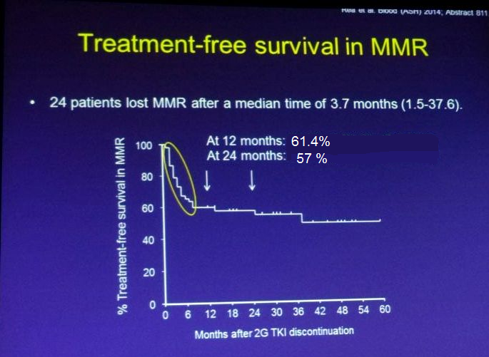
STOP-2G-TKI study: Results
24 pts lost MMR, majority relapses occurred in 6 months
Treatment free survival without MMR loss
  At 12 mo: 61.4%
  At 24 mo: 57%
Landmark analysis of pts who were still in MMR at 6 months; Treatment free survival without MMR loss
  At 12 mo: 91.2%
  At 24 mo: 84.7%

Slide 102
STOP-2G-TKI study: Results
Most relapses occurred very quickly (median 3.7 months)
  1 relapse occurred 24 months &1 at 37 months after stopping treatment
Factors without any impact on outcome
  Gender, age
  Prior interferon exposure
  2G-TKI type
  Treatment duration and duration of CMR4.5 were not found to have.
Prior history of suboptimal response or resistance to imatinib was associated with a significantly lower chance of successful treatment discontinuation
  12-month probability of treatment-free survival without MMR loss of 41.7% in this group compared to 67.3% in other patients (p=0.04).

Slide 103
STOP-2G-TKI study: Conclusion
2G-TKI could be safely and successfully discontinued in CP-CML pts with long-lasting undetectable BCR-ABL transcripts, especially in those without prior history of suboptimal response or resistance.
Most of molecular relapses had an early onset and all were sensitive to 2G-TKI resumption.

Slide 104
ISAV (Imatinib Suspension And Validation) study
Even undetectable BCR-ABL may not equate to eradication of the disease because of the sensitivity of Q-RT-PCR
A new diagnostic method, the digital-PCR (dPCR), able to detect 1 BCR-ABL+ cell out of 10⁷ cells, has been recently developed
dPCR corresponds to a 100 fold increase in sensitivity as compared to Q-RT-PCR
This study aimed at validating the capability of dPCR to predict relapses after imatinib discontinuation in CML pts with negative Q-RT-PCR results
ASH 2014, Abstract # 813

Slide 105
ISAV study: Methods
Patient population:
  CML pts (Chronic or Accelerated Phase) under imatinib therapy since more than 2 years and in complete molecular remission (CMR)
  Pts in CMR for at least 18 months (mts), with a minimum of 3 Q-RT-PCR performed at their own sites
After signing the informed consent, blood samples are obtained for dPCR and the pts discontinue imatinib therapy

Slide 106
ISAV study: Methods
Standard Q-RT-PCR is performed
  Monthly (mts 1-6) and
  Then bimonthly for 36 mts
The loss of molecular remission is defined as
  Two consecutive positive Q-RT-PCR tests
  With at least one BCR-ABL/ABL value above 0.1%.
Patients losing molecular remission resume imatinib treatment at the same dosage used before interruption

Slide 107
ISAV study: Results
Among the 112 pts
  59.3% were male
  37.0% were aged 65 or older
Median duration of imatinib treatment was 103.1 mts
Median duration of CMR of 25.8 mts before imatinib discontinuation
47 pts (43.5%, 95% CI: 34.0-53.4) of the 108 eligible pts relapsed and resumed imatinib
  38/47 (80.9%) of them relapsed in the first 9 mts
  Last relapse occurred 19.6 mts after imatinib discontinuation

Slide 108
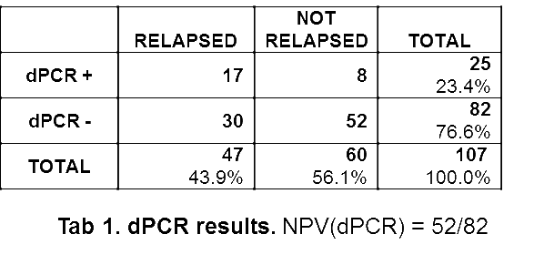
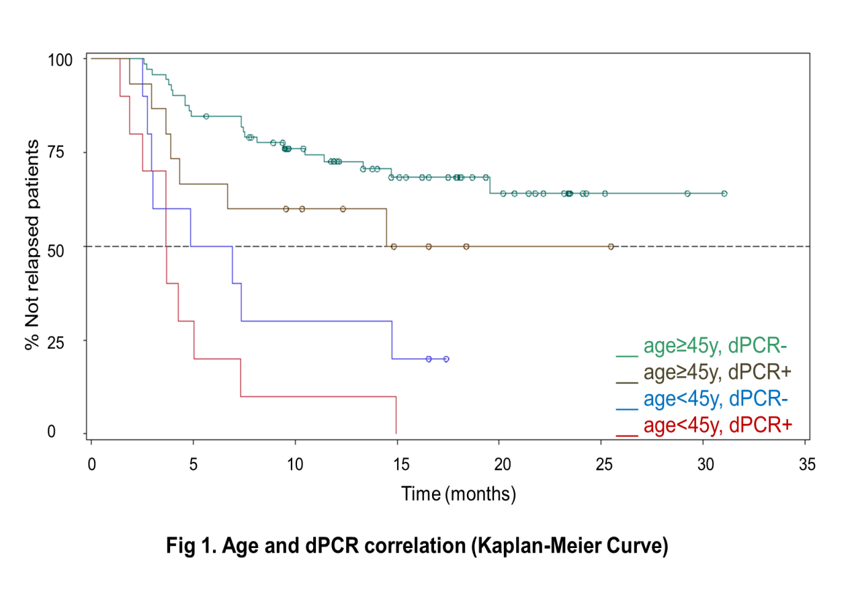
ISAV study: Results
dPCR Negative Predictive Value (NPV) of 63.4%
Pts age and risk of relapse is evident:
  < 45 years- 90%
  45 - < 65 yrs- 37.5%
  ≥ 65 yrs -27.5% [p(χ²)<0.0001]

Slide 109
ISAV study: Conclusions
After 32 mts from the beginning of the study, with a median FUP of 16.6 mts, 43.5% of pts relapsed
Majority of relapses developed in the first 9 months after imatinib discontinuation
Age < 45 years and dPCR positivity are significantly associated with relapses.

Slide 110
KIDS (Korean Imatinib Discontinuation) study
Pts population
  Patients treated with IM for >3 years &
  Undetectable BCR-ABL1 with RQ-PCR for at least 2 years
Data were analysed for 115 people
Median age was much younger (Median 44 years) than in the other STOP studies
Median time on IM therapy 84 months (32 – 149 mo)
Median duration of sustained UMRD prior to discontinuation: 44 months (22 – 131 mo)
ASH 2014, Abstract # 3155

Slide 111
KIDS study: Results
With a median follow-up of 15 months (range, 0.2 – 45.4), 28 patients loss MMR
Probability of sustained MMR was 73.5 ± 4.3%
12-month probability of sustained MMR was 67.0 ± 5.2%
Univariate analysis -IM duration & UMRD duration before treatment discontinuation had a higher 12-month probability of sustained MMR
Based on results, IM discontinuation with resuming after MMR loss can be applied safely

Slide 112
ASH 2014 Updates

Slide 113
Phase III EPIC: Ponatinib vs Imatinib in Pts With Newly Diagnosed Ph+ CP-CML
Stratified by Sokal risk score:
low (< 0.8) vs
intermediate (0.8 to ≤ 1.2) vs
high (> 1.2)
Early analysis of the randomized, open-label EPIC trial
Terminated early due to safety concerns in ponatinib clinical program (arterial thrombotic events)
Endpoints: BCR-ABL^{IS} < 10% at 3 mos; MMR, MR4, MR4.5; CCyR rates; safety
Ponatinib 45 mg/day orally
(n = 155)
Pts with newly diagnosed
Ph+ CP-CML
(N = 307)
Imatinib 400 mg/day* orally
(n = 152)
Dose modification allowed in both arms for management of AEs
*Dose escalation allowed for suboptimal response up to 800 mg/day (400 mg BID)
Lipton JH, et al. ASH 2014. Abstract 519.
Notes:
AE, adverse event; BID, twice daily; CCyR, complete cytogenetic response; CP-CML, chronic-phase chronic myeloid leukemia; MMR, major molecular response; MR4, molecular response > 4 log reduction; MR4.5, molecular response > 4.5 log reduction; Ph+, Philadelphia chromosome positive.

Slide 114
EPIC: Ponatinib vs Imatinib in Pts With Newly Diagnosed CP-CML
None of the prospectively defined endpoints could be analyzed due to trial termination
Deeper, more rapid response rates with ponatinib vs imatinib
  < 10% BCR-ABL transcripts at 3 mos overall
    Ponatinib: 94%
    Imatinib: 68%
Significantly higher number of patients achieved MMR, MR4, MR4.5 with ponatinib vs imatinib in all risk groups
Greater rate of molecular responses at 3, 6, 9, 12 mos with ponatinib vs imatinib
Higher percentage of CCyR with ponatinib vs imatinib
Lipton JH, et al. ASH 2014. Abstract 519.
Notes:
CCyR, complete cytogenetic response; CP-CML, chronic-phase chronic myeloid leukemia; MMR, major molecular response; MR4, molecular response > 4 log reduction; MR4.5, molecular response > 4.5 log reduction.

Slide 115
EPIC: Ponatinib vs Imatinib in Pts With Newly Diagnosed CP-CML: AEs
More treatment-related AEs with ponatinib vs imatinib
    Ponatinib: rash, abdominal pain, headache, constipation, increased lipase, myalgia, thrombocytopenia
    Imatinib: nausea, muscle spasms, diarrhea
Serious treatment-emergent vascular occlusive events
  Ponatinib (7.0%), imatinib (0.7%)
  11 of 12 pts in ponatinib arm who experienced vascular occlusive events had relevant medical history or ≥ 1 risk factor
Lipton JH, et al. ASH 2014. Abstract 519.
Notes:
AE, adverse event; CP-CML, chronic-phase chronic myeloid leukemia.

Slide 116
PACE: Effect of Early Response to Ponatinib on Outcomes in Pretreated Pts
Objective: Subset analysis (n = 267) of association between early landmark responses with ponatinib and long-term outcomes in heavily pretreated pts (more than 90% ≥ 2 TKIs) with CP-CML in phase II PACE trial
Assessment of responses at 3, 6, and 12 mos
  Molecular: BCR-ABL^{IS} ≤ 0.1% (MMR), ≤ 1%, ≤ 10%
  Cytogenetic: MCyR, ≤ 35% Ph+ metaphases; CCyR, ≤ 0% Ph+ metaphases
  Outcomes: PFS, OS, MR4.5
  Median follow-up: 38.4 mos (range: 0.1-48.6)
Mueller M, et al. ASH 2014. Abstract 518.
Notes:
CCyR, complete cytogenetic response; CP-CML, chronic-phase chronic myeloid leukemia; MCyR, major cytogenetic response; MMR, major molecular response; OS, overall survival; PFS, progression-free survival; Ph+, Philadelphia chromosome positive; TKI, tyrosine kinase inhibitor.

Slide 117
PACE: Effect of Early Response to Ponatinib: 2-Yr PFS, OS
Outcome | 2-Yr PFS Probability, % | P Value | 2-Yr OS Probability, % | P Value
3 mos
MMR | 97 | .0006 | 97 | .0324
No MMR | 67 |  | 84
6 mos
MMR | 95 | < .0001 | 95 | .0428
No MMR | 65 |  | 88
12 mos
MMR | 93 | .0010 | 100 | .0089
No MMR | 74 |  | 93
≤ 1% BCR-ABL by 3 mos associated with longer 2-yr PFS, OS vs BCR-ABL > 1% at 3 mos
Molecular response at 3 mos directly correlated with MR4.5 over time
Response at 3 and 6 mos associated with significant improvement in 2-yr PFS and OS
Notes:
CP-CML, chronic-phase chronic myeloid leukemia; MMR, major molecular response; OS, overall survival; PFS, progression-free survival.

Slide 118
PACE: Effect of Early Response to Ponatinib: Conclusions
Early MMR in BCR-ABL with ponatinib in heavily pretreated pts with CP-CML correlated with improved long-term outcomes
2-yr PFS and OS significantly associated with positive 3-mo, 6-mo, and 12-mo cytogenetic and molecular responses
Mueller M, et al. ASH 2014. Abstract 518.
Notes:
CP-CML, chronic-phase chronic myeloid leukemia; MMR, major molecular response; OS, overall survival; PFS, progression-free survival.

Slide 119
Early Predictors of Survival in Pts With CML Treated With Imatinib
Prognostic significance of 3-mo and
6-mo BCR-ABL^{IS} vs 0.5 log reduction of BCR-ABL* at
3 mos from baseline according to sensitivity and specificity of BCR-ABL landmarks in pts with imatinib-treated CML in CML-Study IV
  BCR-ABL landmarks applied to pts with later disease progression (accelerated phase, blast phase, or death)
  Measured: 8-yr PFS
*Calculated from BCR-ABL ratio at 3 mos and at diagnosis.
Hanfstein B, et al. ASH 2014. Abstract 156.
Notes:
CML, chronic myeloid leukemia; PFS, progression-free survival.

Slide 120
Early Predictors of Survival in Pts With CML Treated With Imatinib: Results
BCR-ABL^{IS} | n (%) | 8-Yr PFS, % | HR | P Value | Sensitivity, % | Specificity, %
At 3 mos
≤ 10% | 499 (73) | 90 | 2.2 | .001 | 41 | 75
> 10% | 187 (27) | 82
At 6 mos
≤ 10% | 690 (88) | 91 | 2.4 | .001 | 18 | 94
> 10% | 91 (12) | 79
At 6 mos
≤ 1% | 497 (64) | 93 | 2.7 | <.001 | 40 | 69
> 1% | 284 (36) | 84
Reduction (at 3 mos)
0.5 log | 243 (84) | 94 | 5.0 | < .001 | 43 | 87
< 0.5 log | 48 (16) | 75
Hanfstein B, et al. ASH 2014. Abstract 156.
Notes:
CML, chronic myeloid leukemia; PFS, progression-free survival.

Slide 121
Conclusions
BCR-ABL transcript level ratio at diagnosis and 3 mos identifies pts with CML on imatinib at risk of disease progression better than current BCR-ABL landmarks
  One-half log reduction at 3 mos from baseline associated with 8-yr PFS of 94% vs 75% for pts with smaller transcript reduction
Good specificity and sensitivity
Current BCR-ABL^{IS} landmarks trade off sensitivity and specificity in identifying risk of progression in subset of patients in CML-Study IV
3-mo 10% BCR-ABL^{IS} landmark has higher sensitivity but lower specificity than 6-mo 10% BCR-ABL^{IS} landmark
Hanfstein B, et al. ASH 2014. Abstract 156.
Notes:
CML, chronic myeloid leukemia; PFS, progression-free survival.

Slide 122
ASH 2015 Updates

Slide 123
Ponatinib in T315I+ CML/ALL:
Study Design
Retrospective observational study of pooled data of TKI inhibitor ponatinib^{[1]}
  Observational period: date of treatment intervention to either death or end of data availability
  Adult pts with T315I+ CML (any phase) or treatment-naïve Ph+ ALL, excluding allo-SCT pts in second CP, stratified by CML phase and Ph+ ALL (N = 671)
    Pts treated with ponatinib in PACE trial^{[2]} (n = 449)
      Single-arm phase II study of ponatinib safety/efficacy in T315I+ Ph+ ALL and CML (all phases) pts with dasatinib or nilotinib resistance or intolerance
    Pts treated with allo-SCT, from EBMT Registry (n = 222)
      T315I+ CML and treatment-naïve Ph+ ALL pts with TKI resistance, registered 1999-2010 (pre-ponatinib)
  Primary endpoint: OS
1. Nicolini FE, et al. ASH 2015. Abstract 480.
2. Cortes JE, et al. N Engl J Med. 2013;369:1783-1796.
Notes:
ALL, acute lymphoblastic leukemia; allo-SCT, allogeneic stem cell transplantation; CML, chronic myeloid leukemia; CP, chronic phase; EBMT, European Bone Marrow Transplant; Ph, Philadelphia chromosome; TKI, tyrosine kinase inhibitor.

Slide 124
Ponatinib in T315I+ CML/ALL:
Adjusted OS
Adjusted OS | Ponatinib | Allo-SCT | P Value
CP-CML, n OS, median mos (IQR) HR (95% CI) | 64 NR (45.9-NR) 0.37 (0.16-0.84) | 26 103.3 (6.6-103.3) -- | .013 .017
AP-CML, n OS, median mos (IQR) HR (95% CI) | 18 NR (24.6-NR) 0.90 (0.20-4.10) | 8 55.6 (11.4-NR) -- | .889 .889
BP-CML, n OS, median mos (IQR) HR (95% CI) | 24 7.0 (3.5-11.0) 2.29 (1.08-4.82) | 17 10.5 (5.8-49.9) -- | .026 .030
Ph+ ALL, n OS, median mos (IQR) HR (95% CI) | 22 6.7 (4.0-15.3) 2.77 (0.73-10.56) | 5 32.4 (7.8-NR) -- | .119 .136
For CP-CML, ponatinib achieved significantly longer adjusted OS vs allo-SCT
For BP-CML, allo-SCT achieved significantly longer adjusted OS vs ponatinib
Although not significant, OS for Ph+ ALL was longer for allo-SCT vs ponatinib
Nicolini FE, et al. ASH 2015. Abstract 480.
Notes:
ALL, acute lymphoblastic leukemia; allo-SCT, allogeneic stem cell transplantation; AP, accelerated phase; BP, blast phase; CML, chronic myeloid leukemia; CP, chronic phase; IQR, interquartile range; NR, not reached.

Slide 125
Ponatinib in T315I+ CML/ALL: Conclusions
Ponatinib achieved significantly longer OS in pts with T315I+ CP-CML compared with allo-SCT
OS was similar for ponatinib compared with allo-SCT in AP-CML
In BP-CML and treatment-naïve Ph+ ALL, OS was longer for pts receiving allo-SCT
Authors concluded that results warrant consideration of ponatinib as an alternative to allo-SCT for pts with T315I+ CP-CML
Authors suggest further studies on this topic
Nicolini FE, et al. ASH 2015. Abstract 480.
Notes:
ALL, acute lymphoblastic leukemia; allo-SCT, allogeneic stem cell transplantation; AP, accelerated phase; BP, blast phase; CML, chronic myeloid leukemia; CP, chronic phase; Ph, Philadelphia chromosome.

Slide 126
Radotinib vs Imatinib in CML: Study Design
Open-label, randomized phase III study of TKI radotinib
Primary endpoint: MMR by 12 mos
Secondary endpoints: CCyR and CMR by 12 mos; MMR at 12 mos; PD
Other endpoints: OS, PFS
1 yr
Stratified by Sokal risk score
Radotinib 300 mg BID
(n = 79)
Adult pts (4 Asian countries) with Ph+ chronic phase
CML ≤ 3 mos since diagnosis, ECOG PS 0-2, previous therapy limited to hydroxyurea, anagrelide or < 8 days of imatinib
(N = 241)
Radotinib 400 mg BID
(n = 81)
3-yr extension study
Imatinib 400 mg QD
(n = 81)
Kwak J-Y, et al. ASH 2015. Abstract 476.
Notes:
CCyR, complete cytogenetic response; CMR, complete molecular response; ECOG, Eastern Cooperative Oncology Group; MMR, major molecular response; PD, progressive disease; Ph, Philadelphia chromosome; PS, performance status; TKI, tyrosine kinase inhibitor.

Slide 127
Radotinib vs Imatinib in CML: 12-Mo MMR
Outcome, % | Radotinib 300 mg BID (n = 79) | Radotinib 400 mg BID (n = 81) | Imatinib 400 mg QD (n = 81)
MMR by 12 mos P value vs imatinib | 52 .0044 | 46 .0342 | 30
MMR at 12 mos P value vs imatinib | 47 .0065 | 33 .0667 | 25
MMR: transcript level BCR-ABL/ABL ≤ 0.1%^{IS}
By 12 mos, MMR significantly higher for radotinib at both doses vs imatinib
At 12 mos, MMR for radotinib 300 mg significantly higher than imatinib
Kwak J-Y, et al. ASH 2015. Abstract 476.
Notes:
CML, chronic myeloid leukemia; MMR, major molecular response.

Slide 128
Radotinib vs Imatinib in CML: Other Outcomes
Outcome, % | Radotinib 300 mg BID (n = 79) | Radotinib 400 mg BID (n = 81) | Imatinib 400 mg QD (n = 81)
CMR* by 12 mos P value vs imatinib | 15 .2012 | 14 .3274 | 9
CCyR† by 12 mos P value vs imatinib | 91 .0120 | 82 .4302 | 77
BCR-ABL1 transcripts ≤ 10%^{IS} at 3 mos P value vs imatinib | 86 .0179 | 87 .0096 | 71
Treatment failure‡ at 12 mos | 0 | 3 | 6
Suboptimal response‡ at 12 mos | 1 | 0 | 4
*CMR: transcript level BCR-ABL/ABL ≤ 0.0032%^{IS}. †CCyR: 0% Ph+ metaphase (FISH not allowed).
‡Assessed according to ELN 2009 recommendations.
CCR by 12 mos for radotinib 300 mg significantly higher than imatinib, whereas both doses significantly better vs imatinib at reducing BCR-ABL1 transcripts at 3 mos
Kwak J-Y, et al. ASH 2015. Abstract 476.
Notes:
CCyR, complete cytogenetic response; CML, chronic myeloid leukemia; CMR, complete molecular response; ELN, European Leukemia Net; Ph, Philadelphia chromosome.

Slide 129
Radotinib vs Imatinib in CML: AEs
AE,* % | Radotinib 300 mg BID (n = 79) |  | Radotinib 400 mg BID (n = 81) |  | Imatinib 400 mg QD (n = 81)
 | All | Grade 3/4 | All | Grade 3/4 | All | Grade 3/4
Edema | 3 | 0 | 4 | 0 | 35 | 1
Muscle disorder | 15 | 0 | 20 | 1 | 33 | 3
Diarrhea | 9 | 1 | 5 | 0 | 14 | 1
Nausea/vomiting | 23 | 4 | 24 | 3 | 27 | 1
Musculoskeletal pain | 13 | 1 | 10 | 0 | 12 | 0
Rash | 35 | 1 | 33 | 3 | 22 | 4
Pruritus | 19 | 3 | 31 | 5 | 9 | 0
Headache | 19 | 1 | 31 | 0 | 10 | 0
Grade 3/4 hematologic AEs
Thrombocytopenia | -- | 17 | -- | 14 | -- | 20
Anemia | -- | 6 | -- | 10 | -- | 5
Neutropenia | -- | 19 | -- | 24 | -- | 30
*≥ 20% of pts, regardless of causality.
Kwak J-Y, et al. ASH 2015. Abstract 476.
Notes:
AE, adverse event; CML, chronic myeloid leukemia.

Slide 130
Radotinib vs Imatinib in CML: Grade 3/4 Lab Abnormalities
Lab Abnormalities, % | Radotinib 300 mg BID (n = 79) | Radotinib 400 mg BID (n = 81) | Imatinib 400 mg QD (n = 81)
Hypophosphatemia | 3 | 3 | 11
Increased amylase | 1 | 0 | 0
Hypocalcemia | 4 | 0 | 0
Hypokalemia | 0 | 1 | 3
Increased lipase | 11 | 7 | 3
Increased ALT | 20 | 26 | 1
Hyperbilirubinemia* | 27 | 42 | 0
Increased AST | 6 | 6 | 1
Hypercholesteremia | 1 | 0 | 0
Hyperglycemia | 11 | 11 | 4
*Managed by dose reduction; n = 3 pts in radotinib 400 mg BID group discontinued.
Deaths in radotinib arms, n = 3 (actinic prurigo, HTN, PD); death in imatinib arm, n = 1 (ARF).
Kwak J-Y, et al. ASH 2015. Abstract 476.
Notes:
ALT, alanine transaminase; ARF, acute respiratory failure; AST, aspartate transaminase; CML, chronic myeloid leukemia.

Slide 131
Radotinib vs Imatinib in CML: Conclusions
In phase III trial of 2 doses of radotinib vs imatinib in pts with newly diagnosed chronic-phase CML
  Radotinib associated with significantly higher molecular response rate
  Treatment failure and suboptimal response lower in radotinib arms
  Safety profiles different, with relatively low incidence of grade 3/4 AEs
    Higher grade 3/4 laboratory abnormalities with radotinib
Authors suggest radotinib as new frontline therapy option in pts with newly diagnosed chronic-phase CML
Kwak J-Y, et al. ASH 2015. Abstract 476.
Notes:
AE, adverse event; CML, chronic myeloid leukemia.

